Slide 1




AWS @ UT Dallas
Linux Users Group

Slide 2
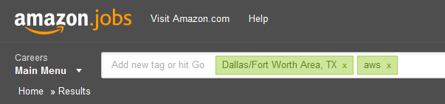
How to apply
http://www.amazon.jobs
Drop off resume at the end of this session
Forward your resume through Daniel Van Allen or Mark Neves
Reach out to me for contact information after this session

Slide 3
Use AWS…
There are several opportunities to use AWS in your daily life, many of which are free!
http://aws.amazon.com/free/
To help new AWS customers get started in the Cloud, AWS offers a free usage tier. The free tier can be used for anything you want to run in the Cloud: launch new applications, test existing applications in the Cloud, or simply gain hands-on experience with AWS.
http://aws.amazon.com/grants/
With AWS in Education, educators, academic researchers, and students can apply to obtain free usage credits to tap into the on-demand infrastructure of the Amazon Web Services cloud to teach advanced courses, tackle research endeavors, and explore new projects – tasks that previously would have required expensive up-front and ongoing investments in infrastructure.
http://aws.amazon.com/activate/
AWS Activate is a program designed to provide startups with the resources needed to get started on AWS with low cost, easy to use infrastructure needed to scale and grow any size business. Some of the world’s hottest startups including Pinterest, Instagram, and Dropbox have leveraged the power of AWS to easily get started and quickly scale.
Join some of the fastest-growing startups in the world and build your business using AWS.
Notes:
Tenured = 3 months

Slide 4
Questions?

Slide 5
Creating an AWS free tier account with CloudWatch billing alerts
Greg
Notes:
Greg will be talking about how to sign up for an AWS account to gain access to the free tier and how to use CloudWatch to configure an alert to warn of charges outside the free tier. Also, how to use big data to find the perfect pair of cowboy boots.

Slide 6
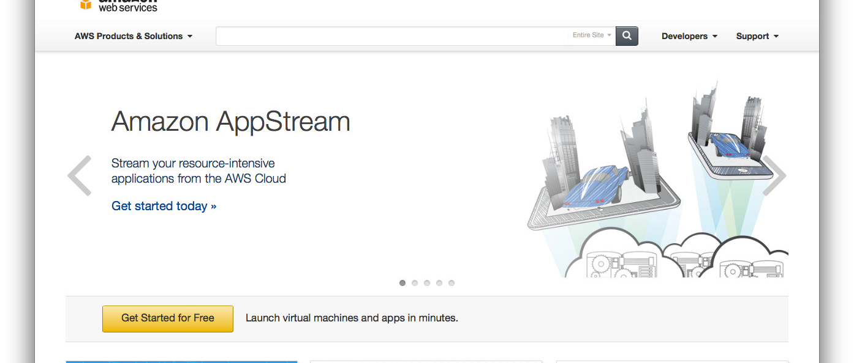
Visit aws.amazon.com

Slide 7
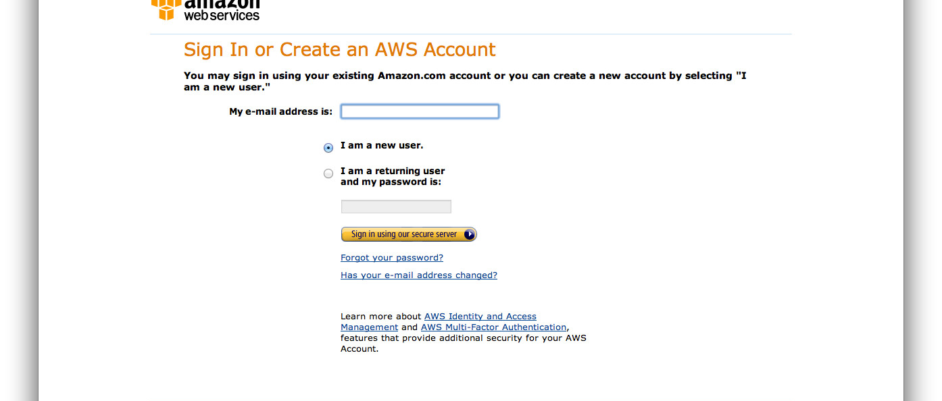
Create an AWS Account

Slide 8
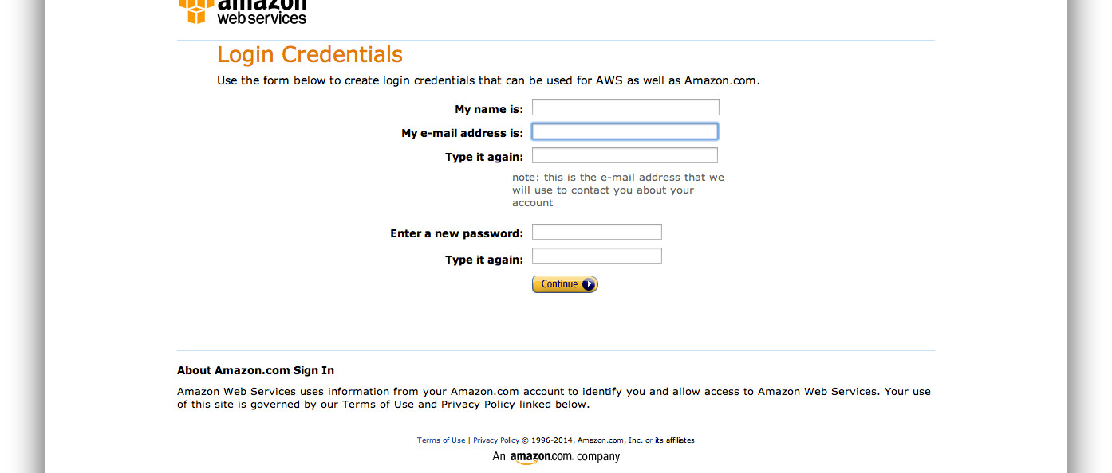
Set Up Your Login Credentials

Slide 9
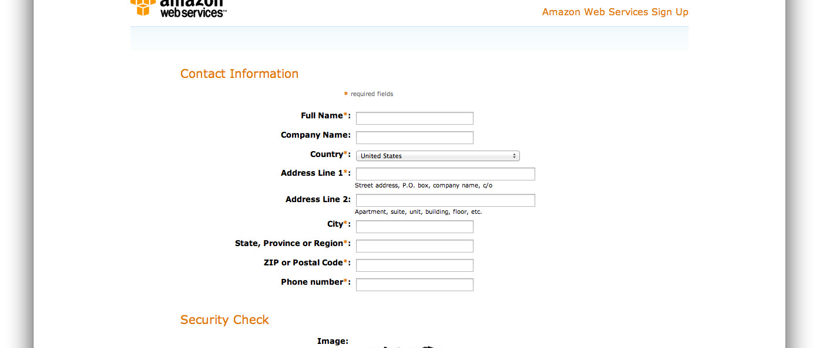
Enter Your Contact Information

Slide 10
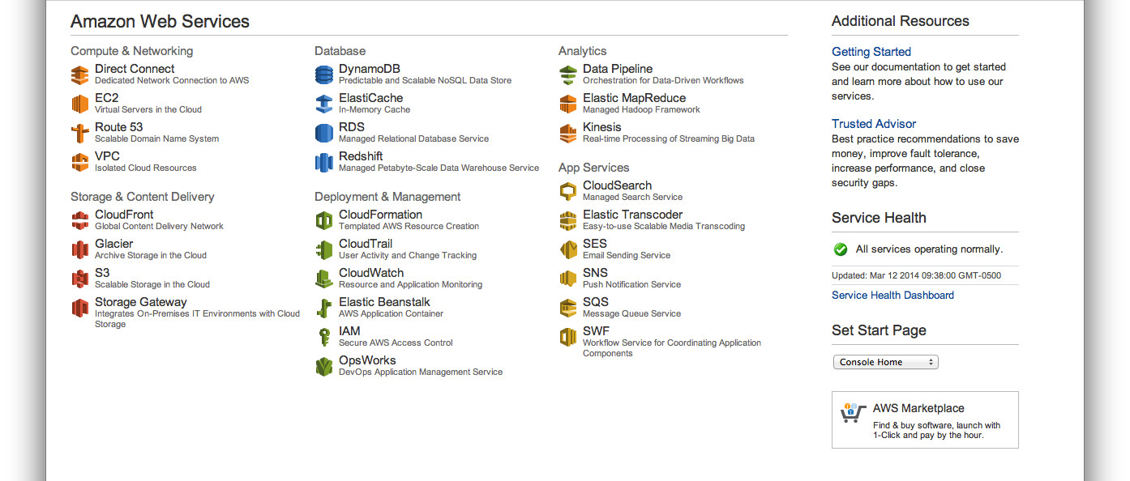
Open the AWS Console

Slide 11
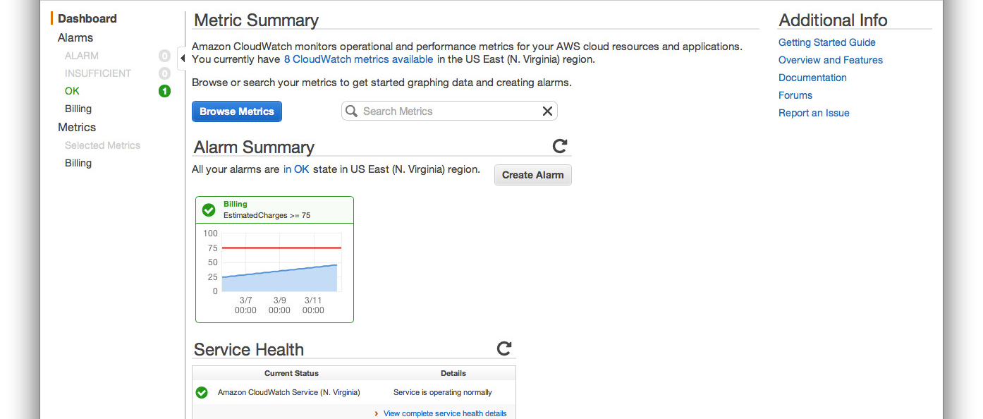
Click Create Alarm

Slide 12
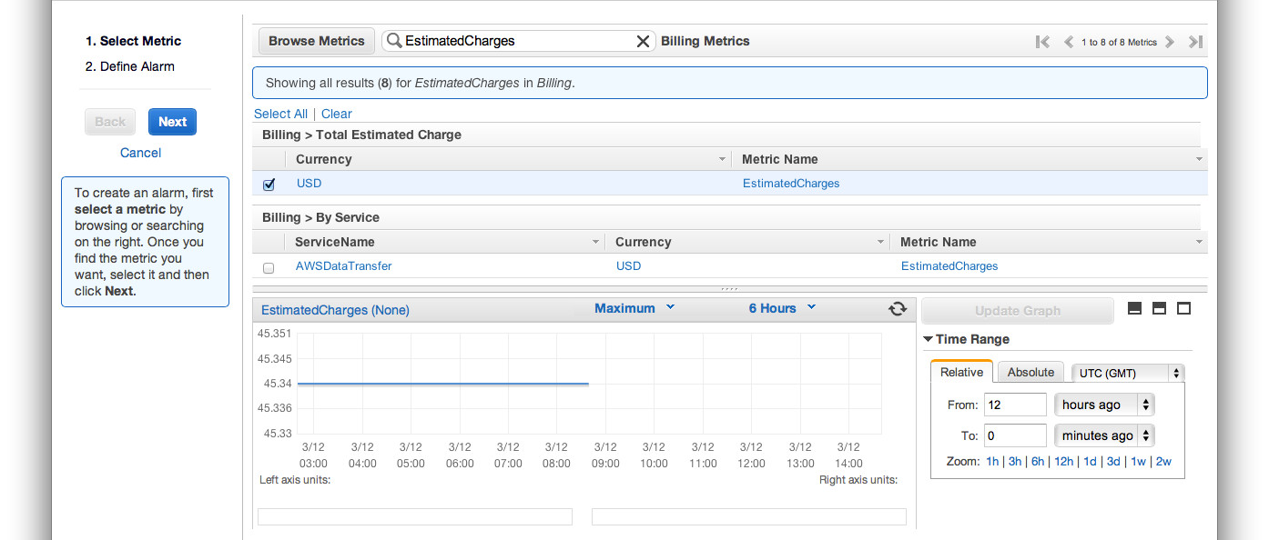
Select The EstimatedCharges Metric

Slide 13
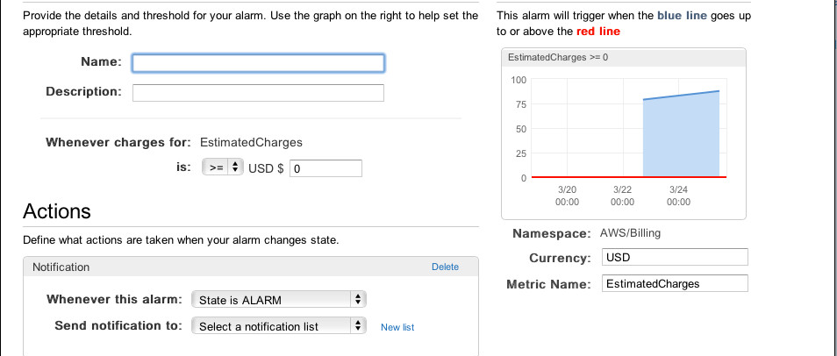
Create the Alarm

Slide 14
What can I run on the AWS free tier?
James
Notes:
James will be discussing some notable companies that use AWS to build their cloud infrastructure (Netflix, Mojang, Dropbox, Reddit, Lamborghini, IMDB, and NASA, Pinterest and Tumblr) and how that same infrastructure can be used for free.
Services in the free tier include EC2, RDS, DynamoDB, S3, EBS, SNS, ELB and CloudWatch.
A brief Linux trivia question about run levels in Linux will be used as an opportunity to hand out some Amazon swag.

Slide 15







Notes:
James will be discussing some notable companies that use AWS to build their cloud infrastructure (Netflix, Mojang, Reddit, Lamborghini, IMDB, and NASA and Pinterest) and how that same infrastructure can be used for free.
Services in the free tier include EC2, RDS, DynamoDB, S3, EBS, SNS, ELB and CloudWatch.
A brief Linux trivia question about run levels in Linux will be used as an opportunity to hand out some Amazon swag.

Slide 16










S3
EBS
CloudWatch
Route 53
ELB
ElastiCache
RDS
EC2
SNS
DynamoDB
Notes:
James will be discussing some notable companies that use AWS to build their cloud infrastructure (Netflix, Mojang, Dropbox, Reddit, Lamborghini, IMDB, and NASA, Pinterest and Tumblr) and how that same infrastructure can be used for free.
Services in the free tier include EC2, RDS, DynamoDB, S3, EBS, SNS, ELB and CloudWatch.
A brief Linux trivia question about run levels in Linux will be used as an opportunity to hand out some Amazon swag.

Slide 17
What can I do from the AWS console?
James
Notes:
James will discuss the EC2 console, how instances and their properties are displayed, availability zones, status checks, security groups and elastic Ips.

Slide 18
How easy is it to set up a LAMP stack on EC2?
Ammon
Notes:
Ammon will discuss configuring a single EC2 linux instance with a full LAMP stack on it.

Slide 19
User Data
#!/bin/bash
yum update -y
yum groupinstall -y "Web Server" "MySQL Database" "PHP Support"
yum install -y php-mysql
chkconfig httpd on
groupadd www
usermod -a -G www ec2-user
chown -R root:www /var/www
chmod 2775 /var/www
find /var/www -type d -exec chmod 2775 {} +
find /var/www -type f -exec chmod 0664 {} +
echo "<?php phpinfo(); ?>" > /var/www/html/phpinfo.php
service httpd start
service mysqld start
Notes:
LAMP Stack is easily configured via ‘userdata’ in the instance launch process, we walk through the launch and confirm it is working.

Slide 20
What else can I do with my new EC2 instance?
Jacob
Notes:
Jacob will be discussing some examples of some use cases that can be used to help out UTD student while in school and for fun.
Use case’s I will be covering are the following.
Installing a Minecraft server using user data.
Installing a Open Source Voice Chat server for gaming using userdata.
Installing a Git Development Environment using user data and talk about the EC2 tool box for Eclipse.

Slide 21
Minecraft User Data
#!/bin/sh
sudo yum update -y #Updates all installed packages
sudo yum install -y screen #Installs Screen to create an independent session
mkdir /home/minecraft/ # creates the directory to store the server files
#Download the new version Minecraft server from the mojang S3 bucket
wget https://s3.amazonaws.com/Minecraft.Download/versions/1.7.5/minecraft_server.1.7.5.jar -O /home/minecraft/minecraft_server.jar.
cd /home/minecraft/ #Sets path to Minecraft server directory
#Adds start command to rc.local to have it auto start on reboot
echo "screen -d -m java -Xmx512M -Xms512M -jar /home/minecraft/minecraft_server.jar" >> /etc/rc.local screen -d -m java -Xmx512M -Xms512M -jar /home/minecraft/minecraft_server.jar #Starts Minecraft Server
Notes:
Minecraft UserData

Slide 22
Mumble User Data
#!/bin/sh
#update the repo cache
apt-get update
apt-get -y dist-upgrade #Do a full update
# install Mumble-server
apt-get -y install mumble-server
Notes:
Mumble Userdata

Slide 23
Git User Data
#!/bin/sh
yum update -y #Updates all installed packages
yum install -y git-all python27 #Installs all Git tools and Python2.7
mkdir /home/ec2-user/Project #Creates Project Directory
#Initializes new Git repository in the Project directory.
git init --bare /home/ec2-user/Project/
#Set Permissions for Project to ec2-user
chown -R ec2-user:ec2-user /home/ec2-user/Project/
Notes:
Git server UserData

Slide 24
NASA Curiosity Rover Landing
Greg

Slide 25
Their Problem
Massive amount of people wanting to watch the landing, live.
High barrier of entry for both hardware/infrastructure and specialized expertise requirements
Need would be short lived – traffic would return to normal shortly after, and extra hardware/personnel would no longer be needed
Notes:
In Fall 2012, NASA's JPL was faced with a problem: The Curiosity rover was about to land on Mars, and the whole world was wanting to watch it happen over the internet.
Now, NASA/JPL is pretty smart when it comes to problem solving, so they knew that this sort of traffic was going to be short lived, and that it made no sense for them to invest the money and time into building the sort of infrastructure that would be required themselves when it would go unused afterwards.

Slide 26
Their Solution
AWS – highly flexible solution with no long term commitment
On demand scalable infrastructure
Multitude of features
Many automated solutions that would otherwise require dedicated personnel
Proven infrastructure – handles hundreds of gigabits a second without breaking a sweat
Notes:
As you can probably guess, they realized that AWS would be a perfect solution to this. We could provide the flexibility they needed, as well as a whole slew of features that would make the process far easier than if they were to roll their own infrastructure. I'm not sure how many of you have had experience with the "old way" of server provisioning and infrastructure management, but if you, like me, have worked in that world, the though of accomplishing this is probably enough to make you wince.
But thankfully, we don't have to live in that world. Their team was able to build a solution using our products and services that allowed them to stream hundreds of gigabits a second, with the content reaching hundreds of thousands of concurrent viewers - and they did this in just a matter of weeks. Let's take a look at the services NASA/JPL used, and why they were important.

Slide 27
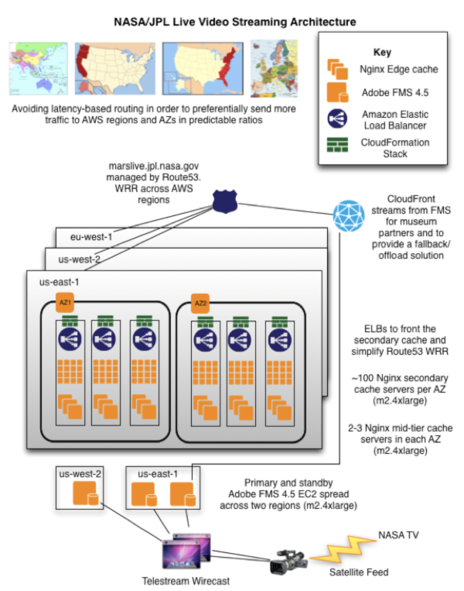
Notes:
AWS offers infrastructure in a lot of different locations across the globe, and we have even more POPs where servers are not directly available. NASA/JPL created a stack of applications and AWS offerings that they deployed worldwide, and then utilizing Amazon Route 53 to make sure people were sent to the stack that offered them the best performance.
Each stack was managed by CloudFormation, which allowed for the automated deployment of their live video streaming infrastructure. Included in each stack were quite a few EC2 instances running a web server called nginx, which is known for it's ability as a reverse proxy or caching server, among other things. In front of these were Elastic Load Balancers, which were used to distribute the traffic to the nginx caching machines. And, since it was managed by CloudFormation, after the rover had landed, and they no longer needed the massive quantity of server instances, how long do you think it took to decommission them? What sort of effort was required? It might surprised you, but the answer is that it was nearly instance, and only one command was needed to turn everything off.

Slide 28
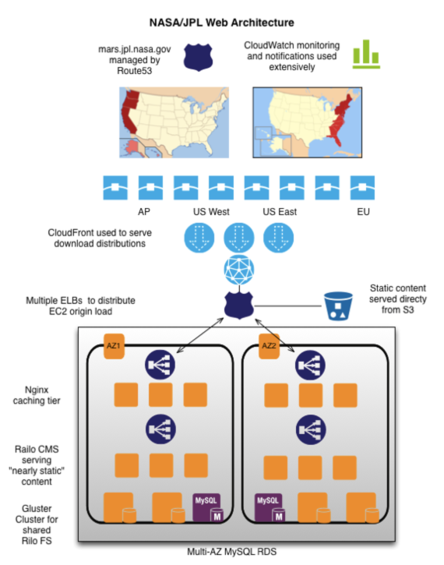
Notes:
Now, the mars.jpl.nasa.gov site runs off of an open source content management system called Railo. The storage used by the CMS was powered by a large quantity of Elastic Block Stores, combined together using the Gluster storage clustering and management software. The database that Railo uses was hosted on the Amazon managed Relational Database Service.
I'm going to take a bit of a step back, and talk about a few things that were used for both the video streaming, as well as the website itself. One of the most important ones is a service we offer called CloudFront. I mentioned before that we have many locations where infrastructure deployed, but all Points of Presence. A POP is a location where we don't offer a full range of services, but instead have a limited subset. In the case of CloudFront, it is a location where we can serve cached content from, making it so that instead of having to download a video or picture from the server in East Virginia when you like in Tokyo, you can get it from the local CloudFront POP, and then everyone else local will also be able to get it from there. We have 36 of these POPs across 5 continents.
One thing that people quickly learn in IT is that monitoring, logging, and reporting are vitally important. Without a well designed solution in place for those, you will often times have to expend a far greater amount of effort to track down an issue, and you might not even know that the issues exists until it's too late. Not only do we provide that with Amazon CloudWatch, but we take it even farther - CloudWatch metrics can be used to trigger actions automatically, so that you never even have the lag of the time it takes a human to be alerted and then implement the fix.
NASA/JPL's use of Amazon extended even beyond the obvious web-type applications as well - Simple Workflow Service was used to take raw images from the rover and process them into Simple Storage Solution, or S3. As the images were received, EC2 instances were spun up to handle the processing automatically, and removed when no longer needed.

Slide 29
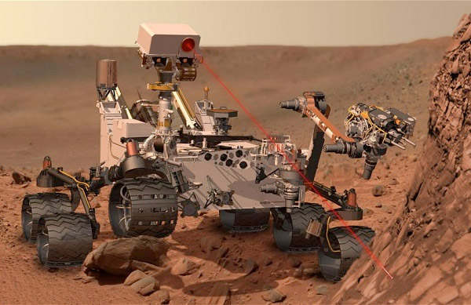
Notes:
Ultimately, the landing was a huge success. I imagine a lot of you had a chance to watch the rover land – I know I had an enjoyable time of it. It was a task that would have been monumentally difficult with a more traditional IT infrastructure, and would have required a large outlay of capital expenditure on hardware for it, as well as having to bring in the people to manage it. Even if they had leased hardware from someone, it would not have been possible to scale it in an automatic and expedient manner. There were also many AWS specific technologies leveraged that simply would not have been available to them otherwise, without having to develop their own implementations – a process that would have severely lengthened the amount of time required.

Slide 30
Questions?

